Slide 1

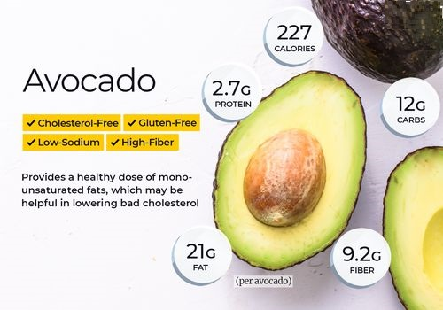
Avocado AVERAGE PRICE Prediction THROUGH
MACHINE LEARNING
PRIYA DAVIS
INSAID – Oct’20

Slide 2

Framework :
Problem Statement
Dataset and Data Description
Data Pre-processing and Cleaning
Exploratory Data Analysis (EDA)
ML readiness – Dummy creation, Data Splitting and Scaling
Linear regression
Decision Tree
Random Forest
Model Evaluation Result Comparisons
Conclusion

Slide 3
Problem Statement:
Avacard-corp avocados are sourced from over 1000 growers owning over 65,000 acres across California, Mexico, Chile, and Peru.
They want to increase their supply throughout the United States and need to make sure that they are selling their products at the best possible price. Due to this uncertainty in the prices, the company is not able to sell their produce at the optimal price.
Task is to predict the optimal price of the avocado using the previous sales data of avocado according to different regions.

Slide 4
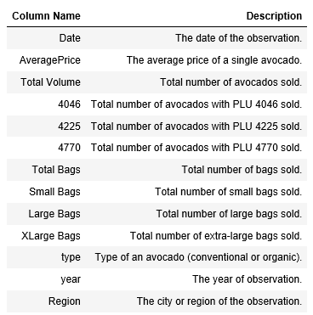
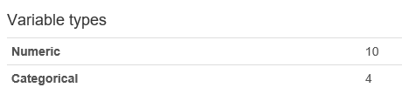

Dataset and Data Description:

Slide 5
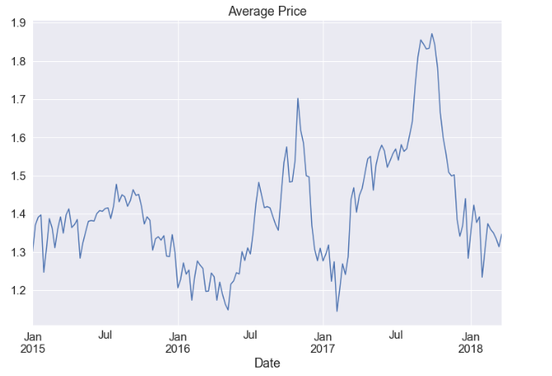
Data Exploration:
Price distribution over the different days in a month
There was a huge hike in prices after July 2017 and before Jan 2018.

Slide 6
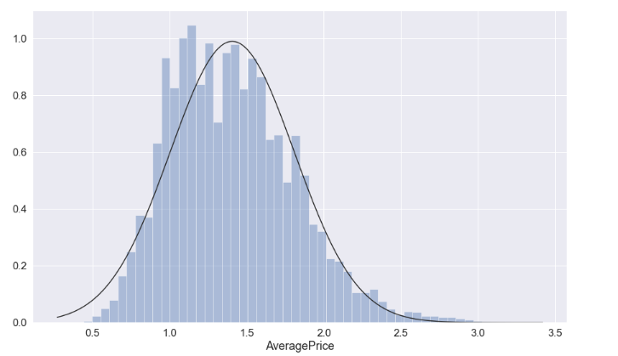
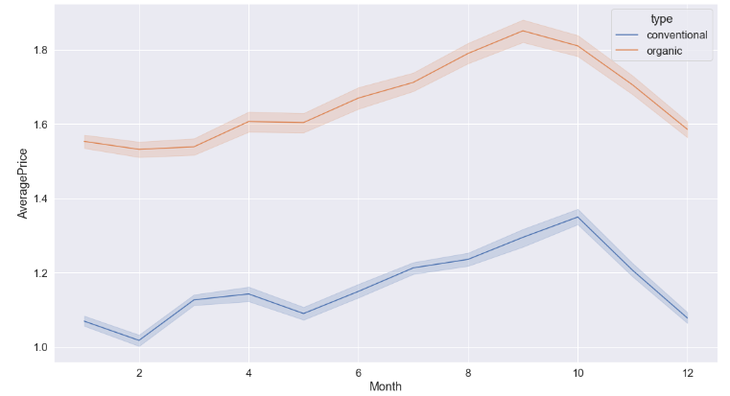
Data Exploration:
Average Price distribution
Average price is slightly rightly skewed because organic avocado are high in price compared to conventional

Slide 7
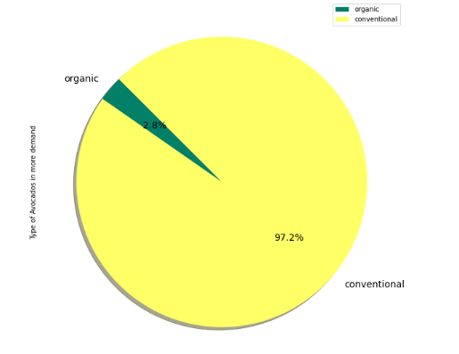
Data Exploration:
Which type of Avocados are more in demand
(Conventional or Organic)?
Only 2.8% of dataset is organic. So above chart shows Conventional type is in more demand.

Slide 8
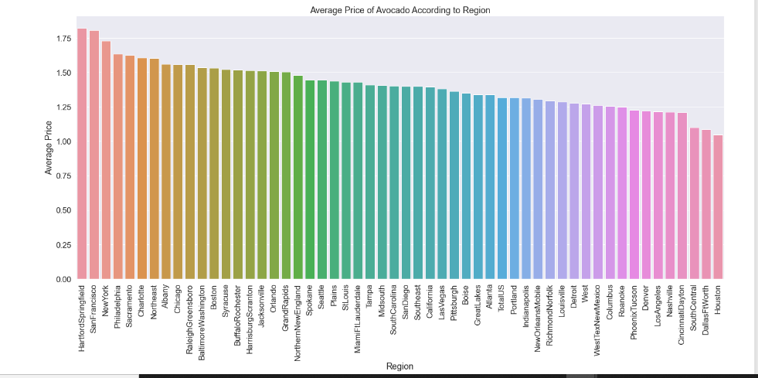
Data Exploration:
TOP 5 regions where Average price is very high
Below are the top 5 regions where price is very high
HartfordSpringfield
SanFrancisco
NewYork
Philadelphia
Sacramento

Slide 9
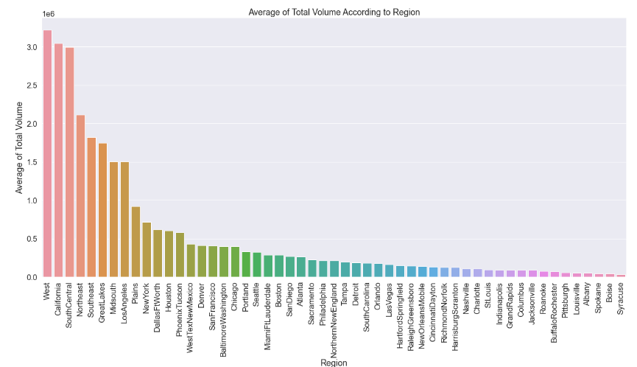
Data Exploration:
TOP 5 regions where Average consumption is very high
Below are the top 5 regions where Consumption is very high
West
California
South Central
Northeast
Southeast

Slide 10
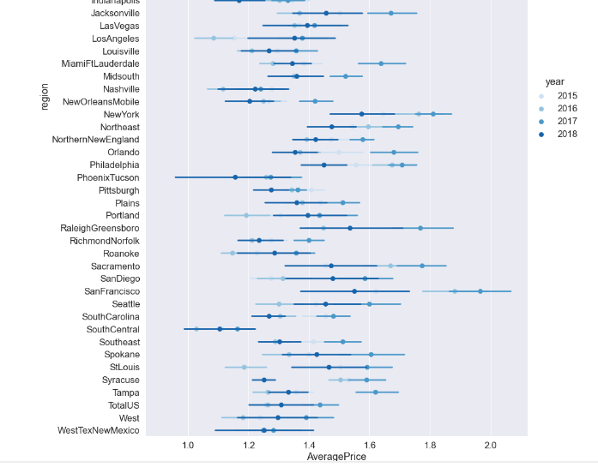
Data Exploration:
In which year and for which region was the Average price the highest?
There was a huge increase in Avocado prices as the demand was little high in Year 2017 in San Franciso region

Slide 11
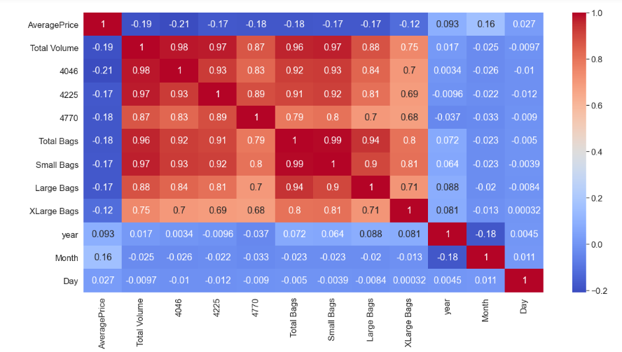
Data Exploration:
Correlation of Features
Heatmap shows all the Features are not correlated with the Average Price column, instead most of them are correlated with each other.

Slide 12
Few Observations:
Every year, prices of Avocados are higher in Second half of year, particularly in the September-October month.
Prices of Avocados are increasing year by year.
Most of the Avocados are in the price range 1.0 to 1.5 dollars.
Hart Ford Springfield has highest average price in year 2017. Also, in San Francisco, there was a high rise in prices in year 2016-2017.
Organic Avocados are costlier as compared to Conventional ones. But Conventional ones are high in demand may be due to low prices.
- Sales of Avocados with Product code of “4225” are higher.

Slide 13
Machine Learning Model:
Train-Test Split :
✓Dataset is divided in the ratio of 80-20.Using 80% of data we train the model and remaining 20% of data is used to test the model
✓Best fit model will be selected using
➢Root Mean Square Error -Low RMSE is good
➢R-Squared ( Explained Variance ) -High R-squared is good
➢Adjusted R-square -High Adjusted R-squared is good
One-Hot Encoding:
✓Performed One Hot Encoding for the Categorical columns using get_dummies() method in python
✓Columns on which One Hot Encoding performed – region, type
Standardization ( Scaling ) :
✓Performed StandardScaler ( Z-score ) fit & transform operation on all the columns to bring different scales onto a single scale

Slide 14
Linear Regression model
Sr No | Metric | Value
1 | Mean Absolute Error | 0.100
2 | Mean Squared Error | 0.021
3 | Root Mean Squared Error | 0.145
4 | R-Square | 0.433
5 | Adjusted R-Square | 0.431

Slide 15
Decision Tree Regression model 1
Sr No | Metric | Value
1 | Mean Absolute Error | 0.100
2 | Mean Squared Error | 0.021
3 | Root Mean Squared Error | 0.145
4 | R-Square | 0.711
5 | Adjusted R-Square | 0.710

Slide 16
Decision Tree Regression model 2
Sr No | Metric | Value
1 | Mean Absolute Error | 0.175
2 | Mean Squared Error | 0.055
3 | Root Mean Squared Error | 0.234
4 | R-Square | 0.656
5 | Adjusted R-Square | 0.655

Slide 17
Decision Tree Model 3 (with Grid Search CV)
Sr No | Metric | Value
1 | Mean Absolute Error | 0.144
2 | Mean Squared Error | 0.045
3 | Root Mean Squared Error | 0.212
4 | R-Square | 0.718
5 | Adjusted R-Square | 0.717

Slide 18
Random Forest Regressor Model 1
Sr No | Metric | Value
1 | Mean Absolute Error | 0.100
2 | Mean Squared Error | 0.021
3 | Root Mean Squared Error | 0.146
4 | R-Square | 0.866
5 | Adjusted R-Square | 0.865

Slide 19
Random Forest Regressor Model 2
Sr No | Metric | Value
1 | Mean Absolute Error | 0.105
2 | Mean Squared Error | 0.023
3 | Root Mean Squared Error | 0.153
4 | R-Square | 0.853
5 | Adjusted R-Square | 0.853

Slide 20
Random Forest Model 3 (with Grid search CV)
Sr No | Metric | Value
1 | Mean Absolute Error | 0.106
2 | Mean Squared Error | 0.023
3 | Root Mean Squared Error | 0.152
4 | R-Square | 0.855
5 | Adjusted R-Square | 0.855

Slide 21
Model Evaluation Result Comparisons
Regression Model | Mean Absolute Error | Mean Squared Error | Root Mean Squared Error | R-Square | Adjusted R-Square
Linear Regression | 0.100 | 0.021 | 0.145 | 0.433 | 0.431
Decision Tree Model 1 | 0.100 | 0.021 | 0.145 | 0.711 | 0.710
Decision Tree Model 2 | 0.175 | 0.055 | 0.234 | 0.656 | 0.655
Decision Tree Model 3 (GSCV) | 0.144 | 0.045 | 0.212 | 0.718 | 0.717
Random Forest Model 1 | 0.100 | 0.021 | 0.146 | 0.866 | 0.865
Random Forest Model 2 | 0.105 | 0.023 | 0.153 | 0.853 | 0.853
Random Forest Model 3 (GSCV) | 0.106 | 0.023 | 0.152 | 0.855 | 0.855

Slide 22
Conclusion:
As per the Model Evaluation results section, it is clear that Random Forest Model 1 is giving the best Prediction Results to predict the average price of Avocado in US.

Slide 23
THANK YOU !!

